Slide 1

Sign Language Recognition
</ai/cv/sign-language>
(for the Deaf and ASL learners)
by Bach Nguyen,
Dat Nguyen,
Nam Nguyen

Slide 2
</ai/cv/sign-language/content>
ASL ?
Why learning ASL
How our app supports learning ASL
Project steps
Data gathering
Data Preprocessing
Modeling
Evaluation
Deploy

Slide 3
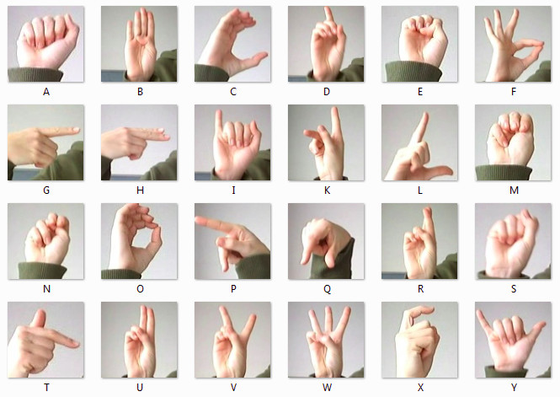
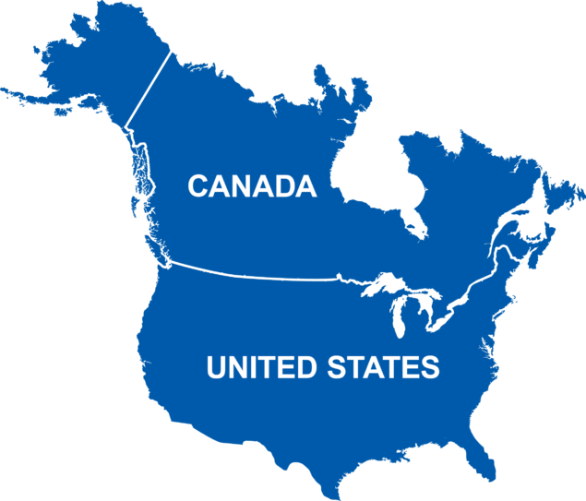

</ai/cv/sign-language/asl>
ASL ?
American Sign Language
For the Deaf and Hard-Of-Hearing
250,000 – 500,000 people in US and Canada
3rd in US,
< Spanish < English

Slide 4

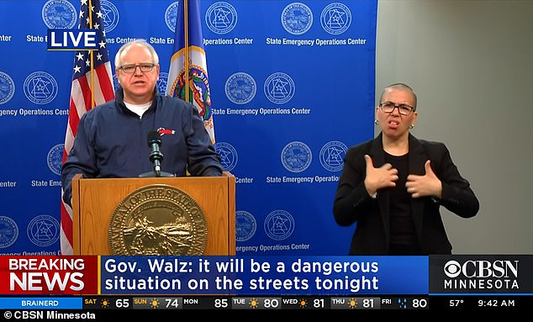

</ai/cv/sign-language/why-asl>
Why learning ASL

Slide 5
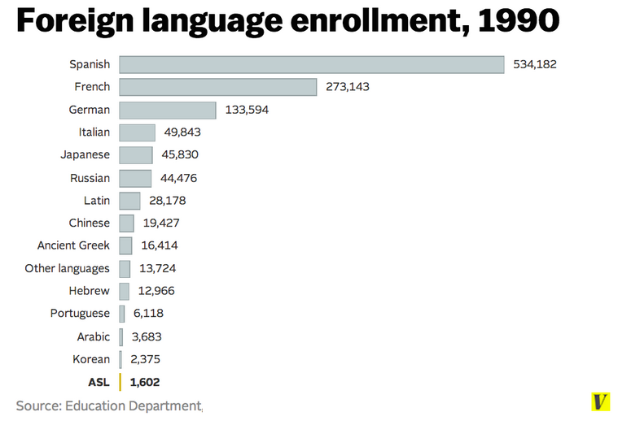
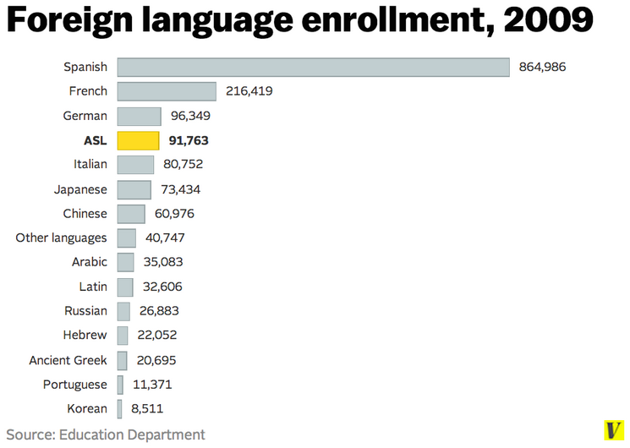

</ai/cv/sign-language/why-asl>
Why learning ASL

Slide 6
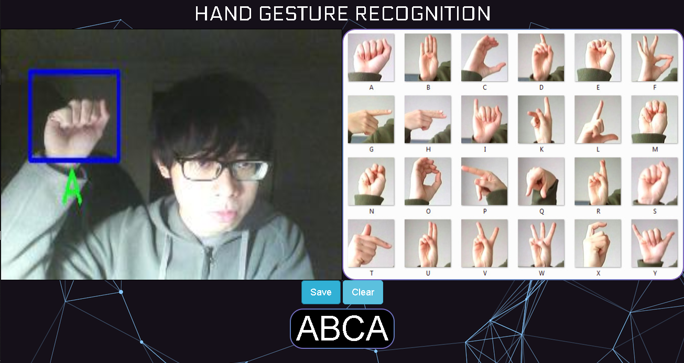
</ai/cv/sign-language/demo>
How our app supports learning ASL
https://sign-language-app.herokuapp.com/

Slide 7
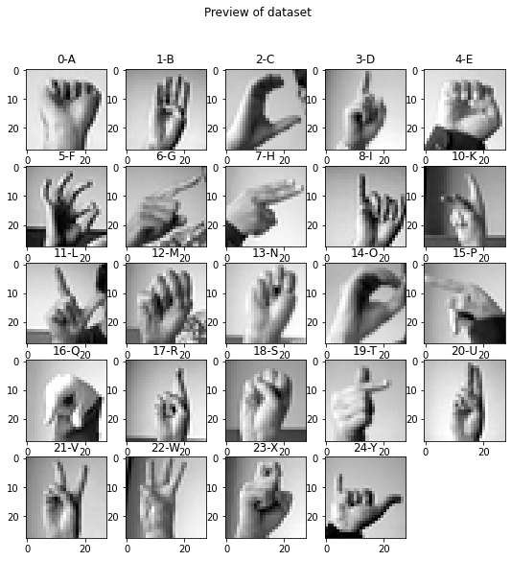
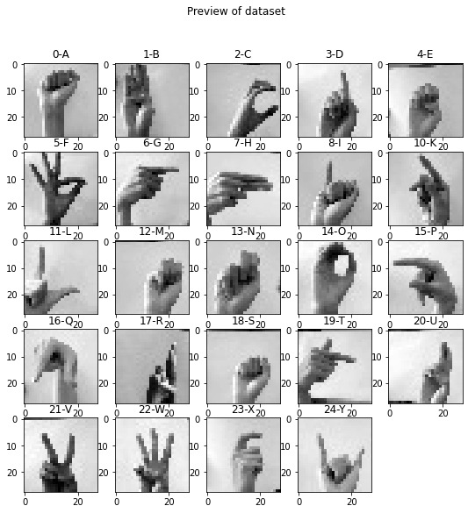
</ai/cv/sign-language/steps>
Project steps
Data Gathering
In-door capturing
(4 lightning schemes)
sign-language-mnist-train.csv + ~700 custom images / character
Out-door capturing
(1 lightning scheme)
sign-language-mnist-test.csv + ~300 custom images / character
Classroom capturing
(1 lightning scheme)

Slide 8
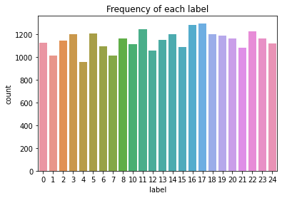
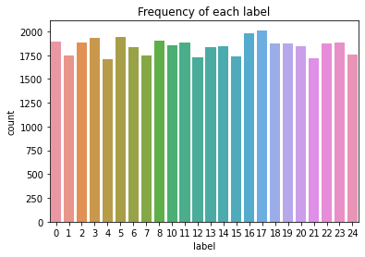
</ai/cv/sign-language/steps>
Project steps
Data Gathering
Sign-language-mnist-train.csv limitations:
Images of only 1 hand from 1 person
Imbalanced data distribution for letters
Custom dataset gains:
Images of hands from 4 people
(including original)
More balanced distribution
(letters with similar gestures having more images than others)

Slide 9
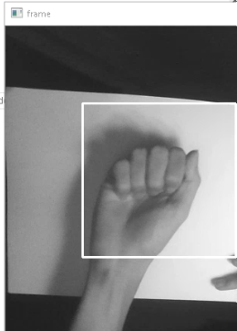
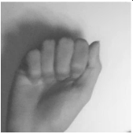


</ai/cv/sign-language/steps>
Project steps
Data Preprocessing
28
28
Data Augmentation
rotate + shifting + zoom

Slide 10
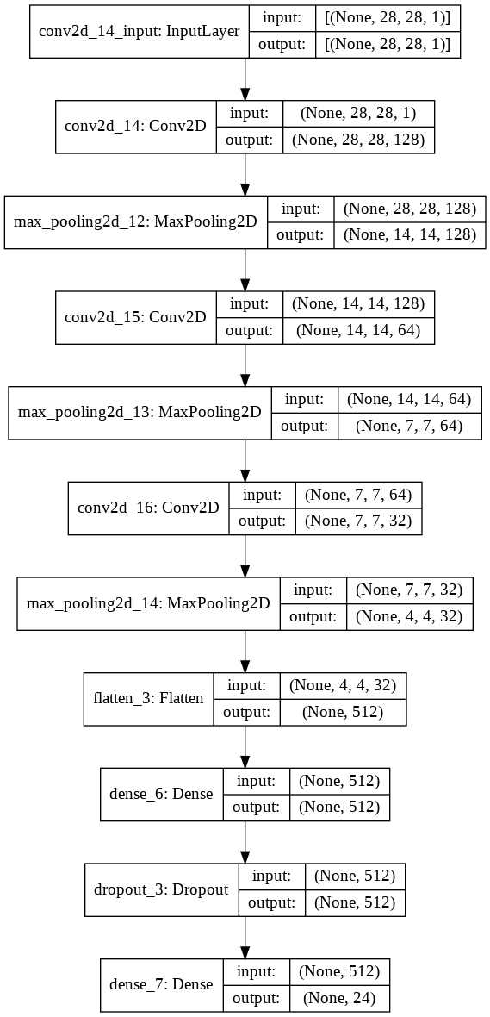
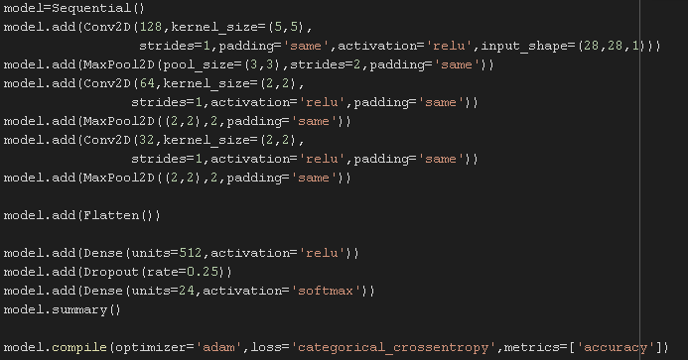
</ai/cv/sign-language/steps>
Project steps
Modeling

Slide 11
</ai/cv/sign-language/steps>
Project steps
 | M | 1.00 | 1.00 | 1.00 | 394
 | N | 1.00 | 1.00 | 1.00 | 291
 | o | 0.96 | 1.00 | 0.98 | 246
 | P | 1.00 | 1.00 | 1.00 | 347
 | Q | 1.00 | 1.00 | 1.00 | 164
 | R | 1.00 | 1.00 | 1.00 | 144
 | S | 0.99 | 1.00 | 0.99 | 246
 | T | 1.00 | 1.00 | 1.00 | 248
 | U | 1.00 | 0.91 | 0.95 | 266
 | V | 0.94 | 1.00 | 0.97 | 346
 | W | 1.00 | 1.00 | 1.00 | 206
 | X | 1.00 | 1.00 | 1.00 | 267
 | Y | 1.00 | 1.00 | 1.00 | 332
accuracy |  |  |  | 0.99 | 7172
Macro | avg | 0.99 | 0.99 | 0.99 | 7172
Weighted | avg | 0.99 | 0.99 | 0.99 | 7172
Evaluation
 | precision | recall | f1-score | support
A | 1.00 | 1.00 | 1.00 | 331
B | 1.00 | 1.00 | 1.00 | 432
C | 1.00 | 0.97 | 0.99 | 310
D | 1.00 | 1.00 | 1.00 | 245
E | 1.00 | 1.00 | 1.00 | 498
F | 0.98 | 1.00 | 0.99 | 247
G | 1.00 | 0.98 | 0.99 | 348
H | 1.00 | 0.99 | 1.00 | 436
I | 1.00 | 1.00 | 1.00 | 288
K | 1.00 | 1.00 | 1.00 | 331
L | 1.00 | 1.00 | 1.00 | 209
Sign-language-mnist-train.csv

Slide 12
</ai/cv/sign-language/steps>
Project steps
 | M | 1.00 | 1.00 | 1.00 | 394
 | N | 1.00 | 1.00 | 1.00 | 291
 | o | 0.96 | 1.00 | 0.98 | 246
 | P | 1.00 | 1.00 | 1.00 | 347
 | Q | 1.00 | 1.00 | 1.00 | 164
 | R | 1.00 | 1.00 | 1.00 | 144
 | S | 0.99 | 1.00 | 0.99 | 246
 | T | 1.00 | 1.00 | 1.00 | 248
 | U | 1.00 | 0.91 | 0.95 | 266
 | V | 0.94 | 1.00 | 0.97 | 346
 | W | 1.00 | 1.00 | 1.00 | 206
 | X | 1.00 | 1.00 | 1.00 | 267
 | Y | 1.00 | 1.00 | 1.00 | 332
accuracy |  |  |  | 0.99 | 7172
Macro | avg | 0.99 | 0.99 | 0.99 | 7172
Weighted | avg | 0.99 | 0.99 | 0.99 | 7172
Evaluation
 | precision | recall | f1-score | support
A | 1.00 | 1.00 | 1.00 | 331
B | 1.00 | 1.00 | 1.00 | 432
C | 1.00 | 0.97 | 0.99 | 310
D | 1.00 | 1.00 | 1.00 | 245
E | 1.00 | 1.00 | 1.00 | 498
F | 0.98 | 1.00 | 0.99 | 247
G | 1.00 | 0.98 | 0.99 | 348
H | 1.00 | 0.99 | 1.00 | 436
I | 1.00 | 1.00 | 1.00 | 288
K | 1.00 | 1.00 | 1.00 | 331
L | 1.00 | 1.00 | 1.00 | 209
Custom dataset

Slide 13
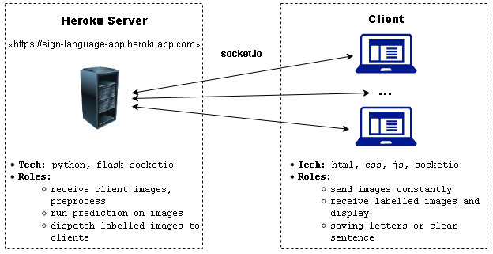
</ai/cv/sign-language/steps>
Project steps
Deploy

Slide 14

THE END
</management/embedded-system>
Thanks for listening

